Slide 1


School of Computer Science and Engineering
Department of Computer Science and Engineering
Classification of Astronomical Objects using Machine Learning
Submitted By:
Pratham Mishra-23FE10CSE00586
Gauri Sharma-23FE10CSE00717
Supervised By:
Mr. Tapan Kumar Dey

Slide 2
Outline
Introduction
Literature Review
Problem Statement
Proposed Solution
Objectives
Results

Slide 3
Introduction
Automates classification of stars, galaxies, and quasars using machine learning
Utilizes labeled data from large-scale SDSS.
Implements an end-to-end pipeline: preprocessing, model training, evaluation, and visualization
Aims to improve accuracy and efficiency in astronomical data analysis
Enables robust identification of celestial objects in expansive datasets

Slide 4
Compares three feed-forward ANN variants: baseline, regularized, and GA-optimized
All models trained on identical feature-engineered photometric dataset (100,000 samples, 13 features)
Stratified 60-20-20 train/validation/test split ensures fair evaluation
Genetic Algorithm used to automatically discover optimal ANN architecture
Performance assessed using accuracy, precision, recall, F1-score, and confusion matrices
Objective: identify ANN design choices that improve astronomical classification performance

Slide 5
Literature Review
•Literature Review - Decision Tree Approaches
Ball et al. (SDSS DR3 Classification)
•Objective:
Classification of 142+ million astronomical objects from SDSS DR3 using machine learning
•Methodology:
Algorithm: Axis-parallel decision trees
Training data: 477,068 spectroscopically classified objects
Classes: Galaxies, Stars, QSOs, and NSNGs
•Key Results:
•Completeness: Galaxies (98.9%), Stars (91.6%), NSNGs (88.5%)
•Efficiency: Galaxies (98.3%), Stars (93.5%), NSNGs (94.5%)
Reliable classifications for magnitude r ≤ 20
Provided probability estimates for each class
•Limitations & Insights:
Inevitable extrapolation from spectroscopic to photometric regime
Performance varies significantly across different object classes
Required extensive supercomputing resources for parameter optimization

Slide 6
Literature Review - Neural Network Approaches
Cavuoti et al. (MLPQNA Classification)
Objective:
•Disentangle different spectral classes using neural network-based MLPQNA model
Methodology:
•Algorithm: Multi-Layer Perceptron with Quasi Newton Algorithm
•Input features: 10 photometric colors from optical data
•Three experimental categories for classification tasks
Key Results:
•Overall efficiency: 90% across classification tasks
•Successfully identified 3.6M QSO candidates (529K robust candidates)
•10 colors performed better than standard 4-color approach
Key Challenges:
•Unable to separate AGNs from normal galaxies using optical data alone
•Multiplicative propagation of errors in hierarchical classification
•Quality filtering required based on user-specific needs
Important Finding:
•Direct classification preferred over hierarchical pairwise approaches

Slide 7
Problem Statement
The vast volume of astronomical data from modern sky surveys makes manual classification of stars, galaxies, and quasars inefficient and error-prone. This project aims to automate and enhance the accuracy of astronomical object classification using machine learning techniques.

Slide 8
Objectives
Develop and implement machine learning models to accurately classify stars, galaxies, and quasars from survey data.
Create a robust data preprocessing pipeline including cleaning, normalization, and feature selection.
Evaluate model performance using metrics like accuracy, precision, and recall to ensure reliable classification.
Compare different classifiers including Decision Tree, Random Forest and ANN to identify the best-performing model.
Identify ANN design choices that improve astronomical classification performance. Baseline, regularized, and GA-optimized.

Slide 9
Proposed Methodology
Data Collection:
Obtained labeled SDSS photometric data of Stars, Galaxies, and Quasars.
Preprocessing & Feature Engineering:
Handled missing values, computed color indices and flux ratios, encoded labels, and applied RobustScaler normalization.
Data Splitting:
Performed stratified 60-20-20 split into training, validation, and test sets.
Regularized ANN Design:
Built deep feed-forward ANN with batch normalization, dropout, and L2 regularization to improve generalization.
GA-Based Architecture Optimization:
Used Genetic Algorithm to evolve ANN architecture (layers, neurons, dropout, L2) based on validation accuracy.
Model Training:
Trained ANN variants using Adam optimizer with EarlyStopping and model checkpointing.
Model Evaluation:
Assessed performance using accuracy, precision, recall, F1-score, log-loss, and confusion matrices.
Explainable AI Analysis:
Applied LIME and SHAP to interpret feature importance and model predictions.
Comparative Analysis:
Compared regularized ANN and GA-optimized ANN in terms of performance, overfitting, and complexity.

Slide 10
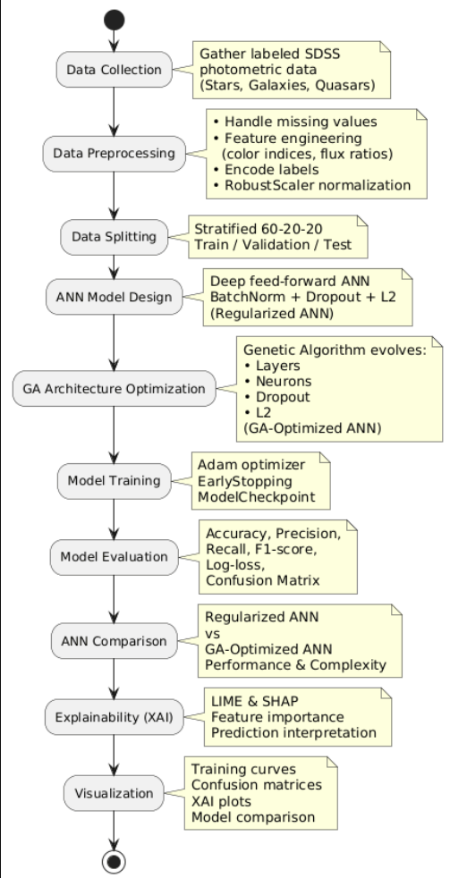

Slide 11
Result
<in tabular, graphical, figures >

Slide 12
Outcome
Research Paper:
A research paper on classifying stars, galaxies, and quasars using regularized and GA-optimized neural networks has been drafted and is planned for submission next semester.
Work Completed This Semester:
Designed and trained a regularized deep ANN for astronomical data classification
Developed a Genetic Algorithm to automatically optimize ANN architecture
Applied LIME and SHAP to understand how the models make predictions
Performed detailed comparison between ANN variants
Planned Next Semester:
Submit research paper to a suitable conference or journal
Extend experiments on larger astronomical datasets
Refine model evaluation and analysis

Slide 13
References
1.Ball, N. M., & Brunner, R. J. (2006). Data Mining and Machine Learning in Astronomy. MNRAS, 372(2), 614-626.
2.Cavuoti, S., Brescia, M., & Longo, G. (2015). Machine Learning for SDSS Classification. MNRAS, 450(4), 3893-3905.
3.Du Buisson, S., et al. (2016). Automated Classification of SDSS Transients. MNRAS, 460(3), 3076-3092.

Slide 14
Thank You

